Slide 1

UIU Eatery -Cafeteria Management System-
System Analysis and Design Laboratory
RU HUNGRY

Slide 2
Our Team
Taiyaba Taskin ID: 011162063
Shifa Chowdhury Iwase ID: 011183003
Md. Jubayer Hossain Sheebly ID:011183017
Md Tarifuzzaman ID: 011191245
Md Sazzad Mazumder ID: 011201285
RU HUNGRY!

Slide 3
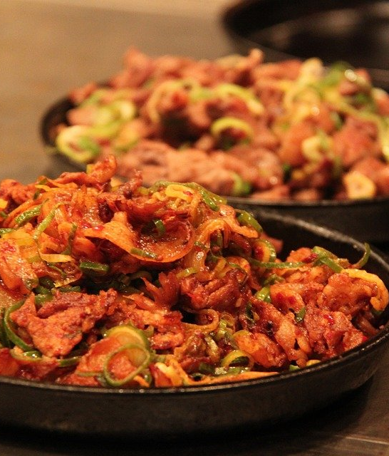
INTRODUCTION
‘‘We are bringing a new genre of
ordering food inside university campus’’
Our aim is to automate the existing way of ordering food for both the students and faculties to ensure an efficient, hassle-free, and profitable system.

Slide 4

MOTIVATION
Huge rush and crowd in cafeteria.
Lack of changes and no coordination.
Student has no specific place to post their homemade food.
Faculties need contacting staffs for room delivery.
Availability of food item cannot be known without physically visiting cafeteria.
RU HUNGRY!

Slide 5
Existing System Studies
Features | Pathao Food | Food Panda | Uber Eats | Hungry Naki? | KFC BD | UIU Eatery
Delivery/Pickup
Review Rating
Order History
Sorting Option
Order Tracking
Multiple Payment Options
Coupons/Vouchers
View Stock Availability
User Monitoring System
In-app restaurant registration
Pathao Food
Food Panda
Uber Eats
Hungry Naki?
KFC BD
RU Hungry!

Slide 6


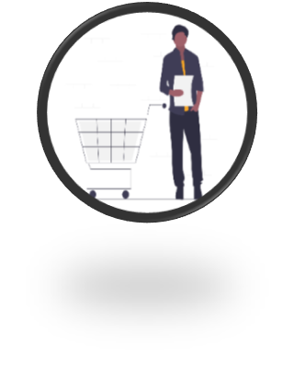




Our Features:
1.User Sign Up/Login 2.Search & Choose item 3. Add to cart & View cart
4. Reg. for homemade 5. Admin approval 6. Payment Options 7. Extra facility for
food supply faculty
RU HUNGRY!

Slide 7

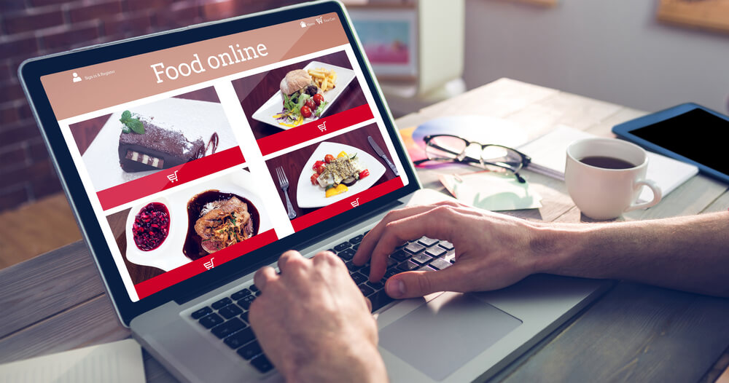
Some other features:
8. Add and update restaurant & menu items
9. Review and rating
10. Stock availability check
11. Order history
12. Sorting option
13. Monitoring user
14. Notification
RU HUNGRY!
Notes:
© Copyright PresentationGO.com – The free PowerPoint template library

Slide 8

Languages & Platform HTML CSS PHP Mysql Bootstrap JavaScript XAMPP VS Code

Slide 9
If you are HUNGRY
Don’t be ANGRY
Just visit EATERY

